Slide 1

CSE- 208
Algorithm Lab
Lab: 01
Fahad Ahmed
Lecturer, Dept. of CSE
E-mail: fahadahmed@uap-bd.edu

Slide 2
Pre-requisite :
CSE 103: Structured Programming
CSE 205: Data Structures

Slide 3
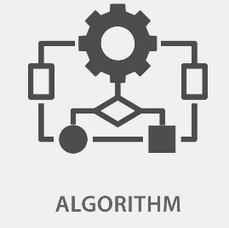
Course Synopsis
Complexity analysis
Divide and Conquer
Greedy algorithm
Dynamic Programming
Backtracking
Graph and Tree related algorithms
NP-Completeness

Slide 4
CO-PO
CO No. | CO Statements: Upon successful completion of the course, students should be able to: | Corresponding POs
CO1 | Explain terms related to basic algorithm, algorithm analysis, and design techniques/paradigm. | 1-Engineering Knowledge
CO2 | Solve practical problems applying the algorithm techniques/paradigms and appropriate data structures. | 3-Design/ development of solutions
CO3 | Analyze the performance / resource requirements of various algorithms. | 4-Investigation

Slide 5
Weighting COs with Assessment methods
Assessment Type | % weight | CO1 | CO2 | CO3
Lab final (Codding Efficiency) (Sessional final) | 30 |  | 30
Lab final Viva (Viva) | 10 | 10
Mid Term Evaluation (Quiz) | 20 | 10 | 5 | 5
Continuous Evaluation (30) + Assignment (10) (Assessment) | 40 |  | 40
 | 100 | 20 | 75 | 5

Slide 6


Tools
Preferred Language: C, C++, Java
IDE: Codeblocks 13.12(C,C++)
IntelliJ IDEA (Java)

Slide 7

Contact
Email: fahadahmed@uap-bd.edu
Mobile: 01737-777912 (8.00AM-8.00PM)

Slide 8

Thanks to All

